Slide 1
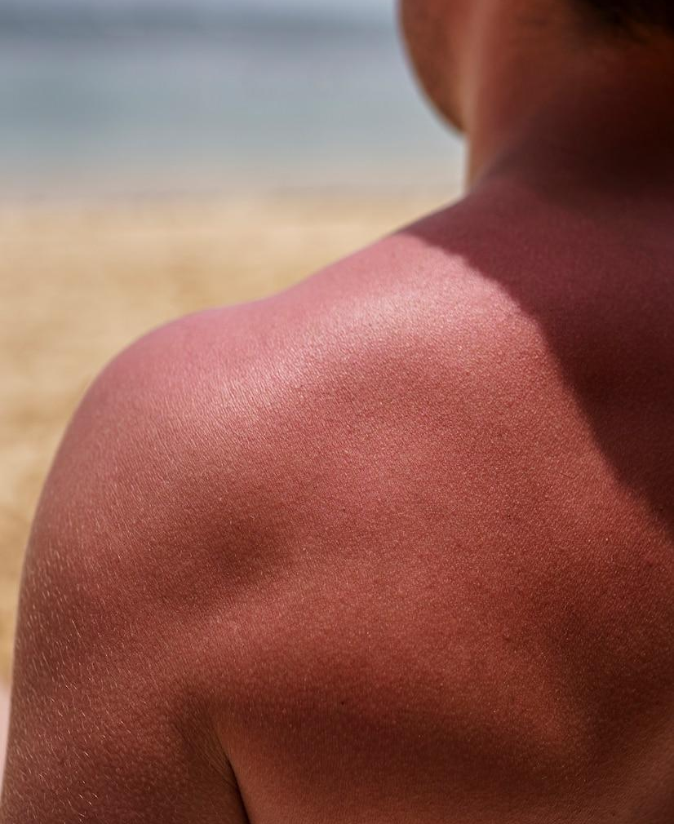
Skin Sight App Multimodal Model
BIODS 295 Munim Moiz, Disha Sharma, Mahek Vara, Katrina Kuo

Slide 2
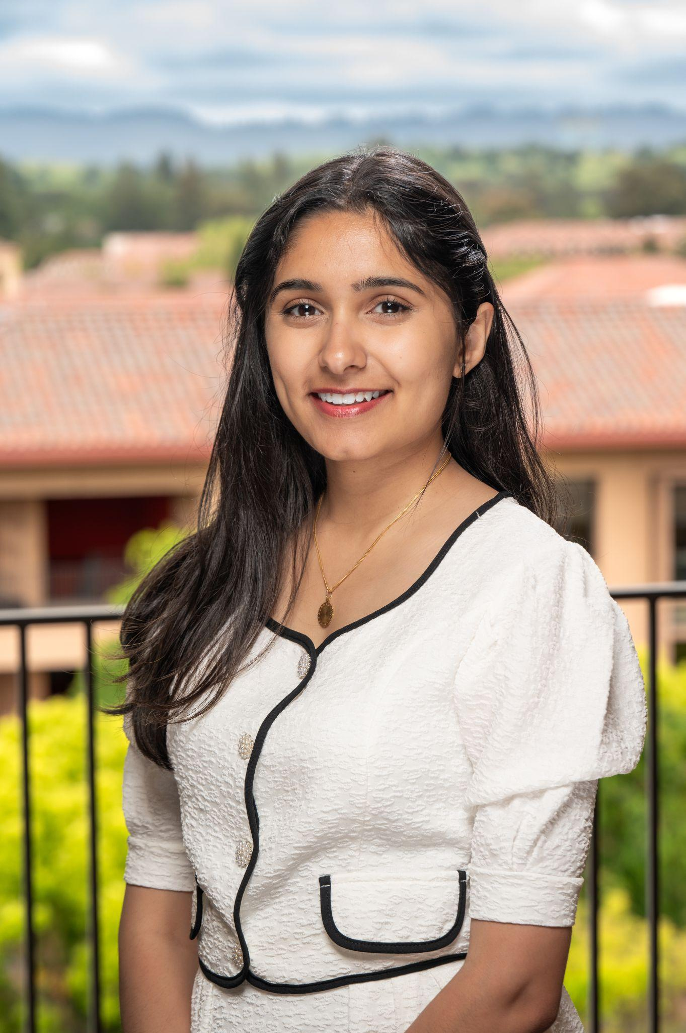
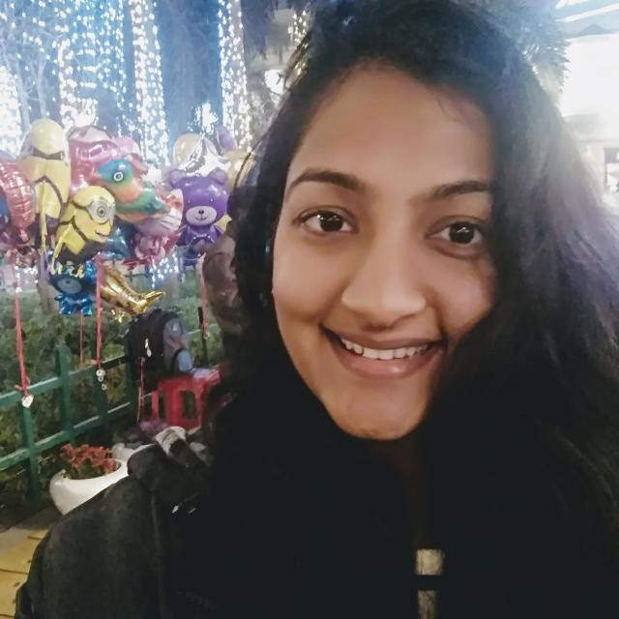
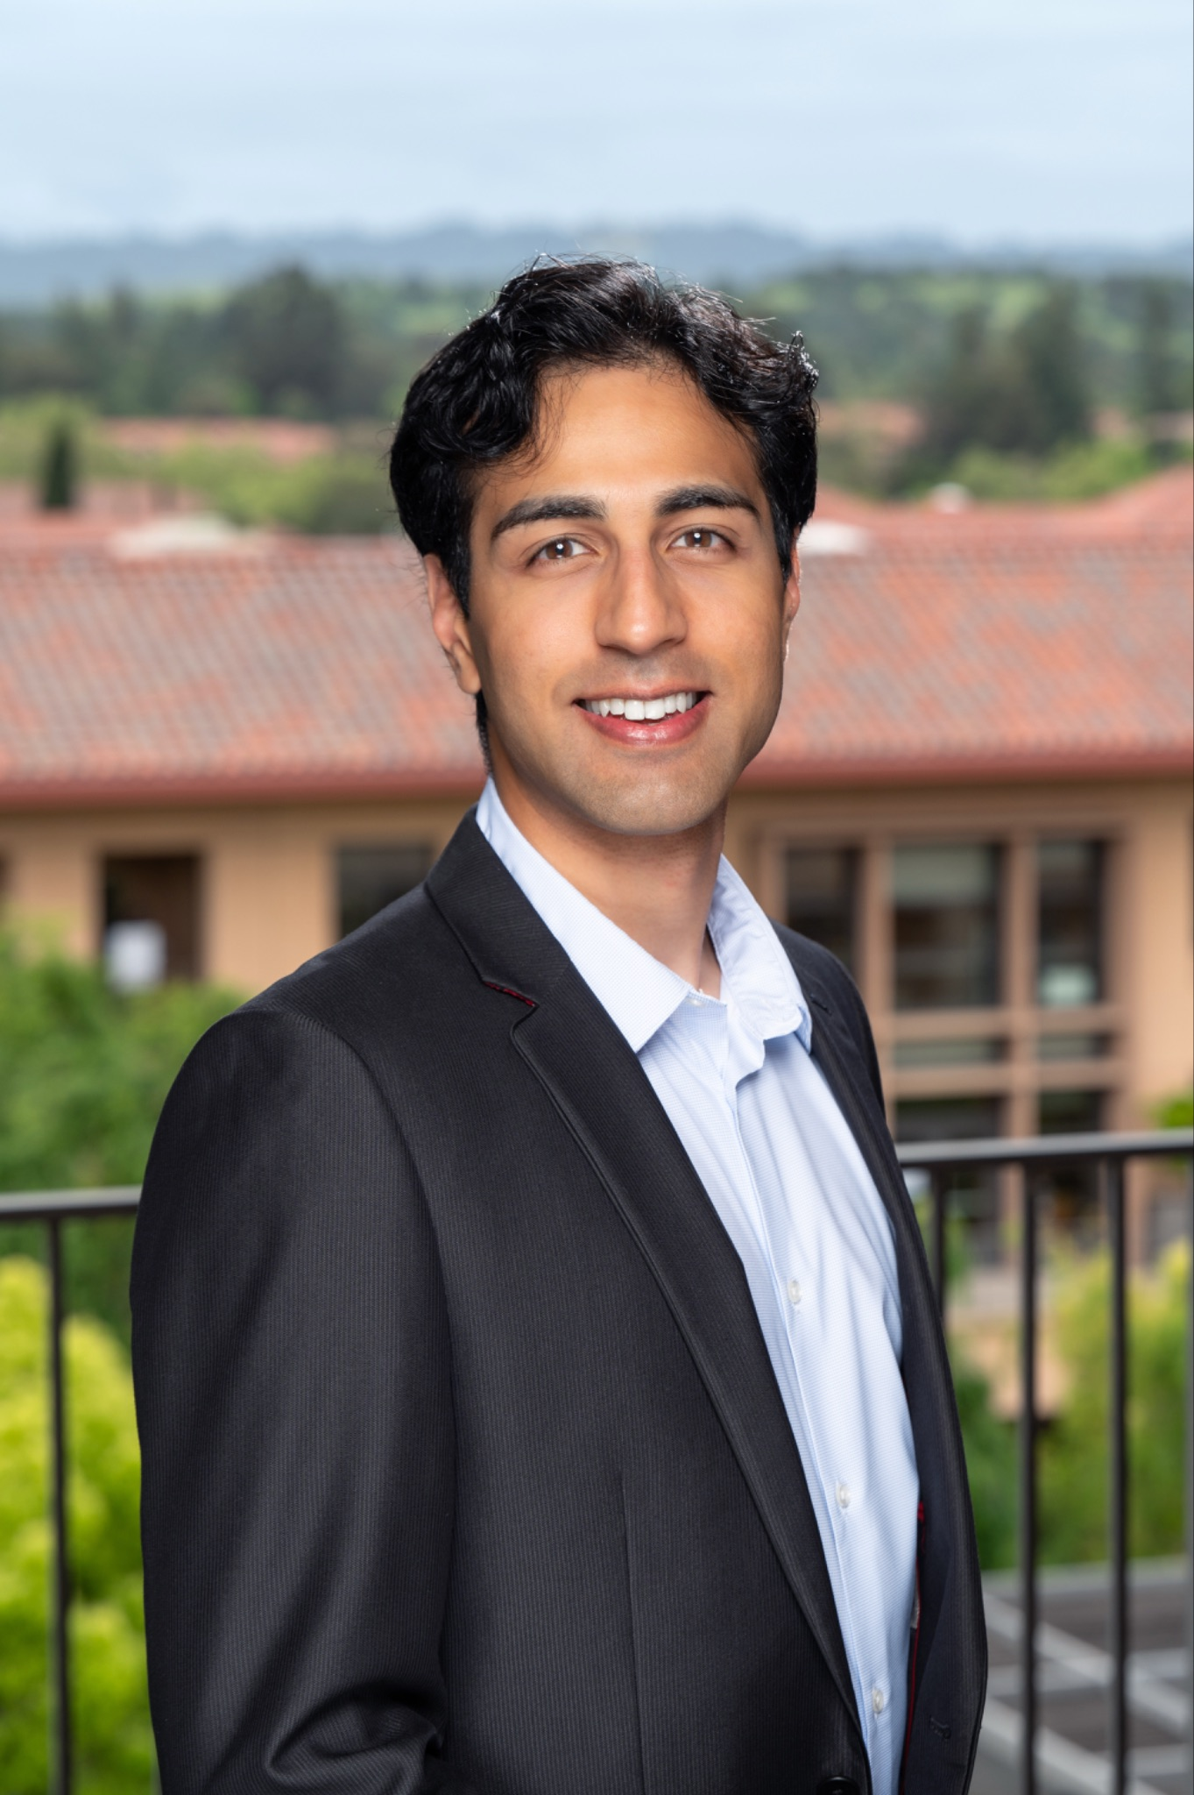
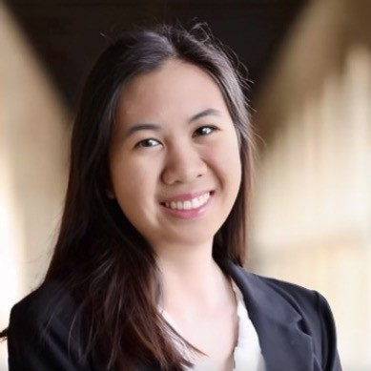
About the Team
Mahek Vara
Disha Sharma
Munim Moiz
Katrina Kuo
MBA ‘25
BSc in Natural Sciences (major in Computer Science)
Disha Sharma
Postdoc, CVMed Stanford
MBA ‘25
MD, BSc, MSc, Dip (Derm)
B.S. Design ‘25 M.S. Management Science &
Engineering ‘25
GTM Strategy
Data Scientist
Clinical Lead & Business Planning
UX/UI & Design Thinking

Slide 3
Outline
01
02
03
04
05
06
Problem Statement
Market Analysis & Business Model
Product Demo
Challenges & Successes
Desired Outcome
Next Steps

Slide 4
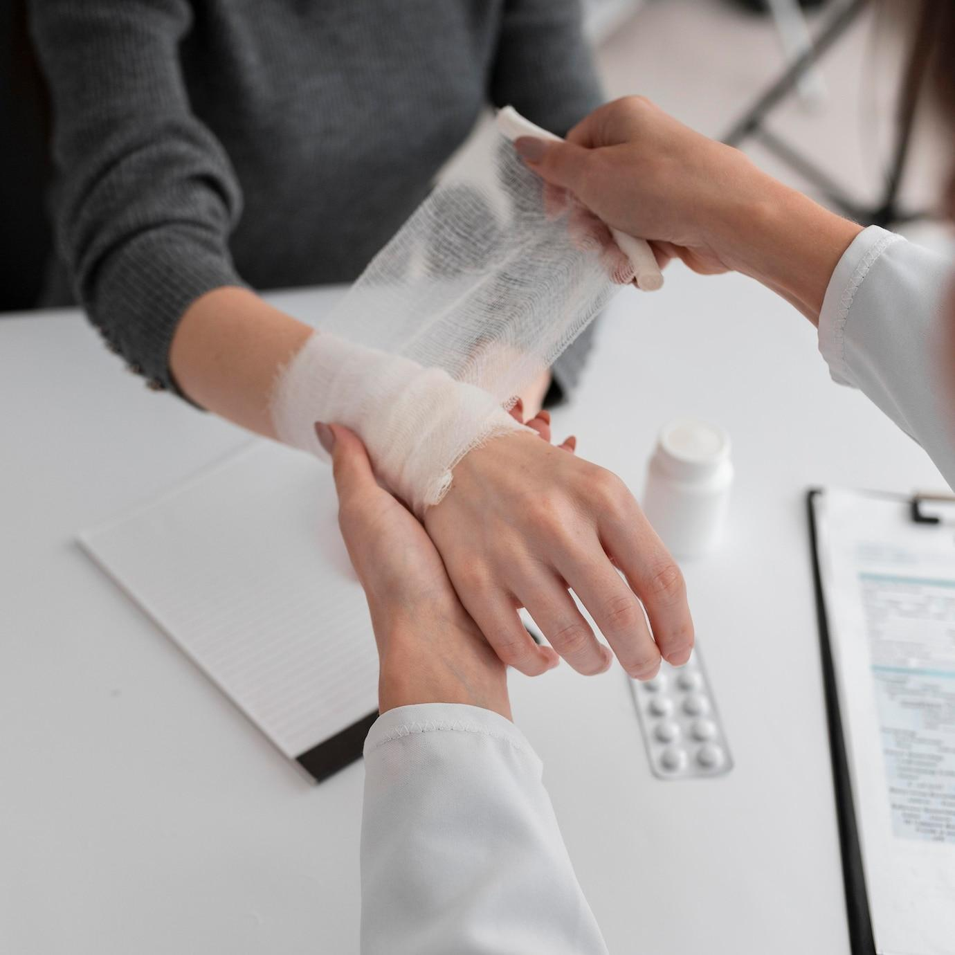
01
Problem Statement

Slide 5

Overview of Problem Statement
1.9bn people worldwide affected by skin conditions¹
Average wait time:
3-6 months to see a Dermatologist
20.6 days to see a PCP²
¹Why Do Patients in the United States Seek Care from Dermatologists?
²Medical Economics

Slide 6

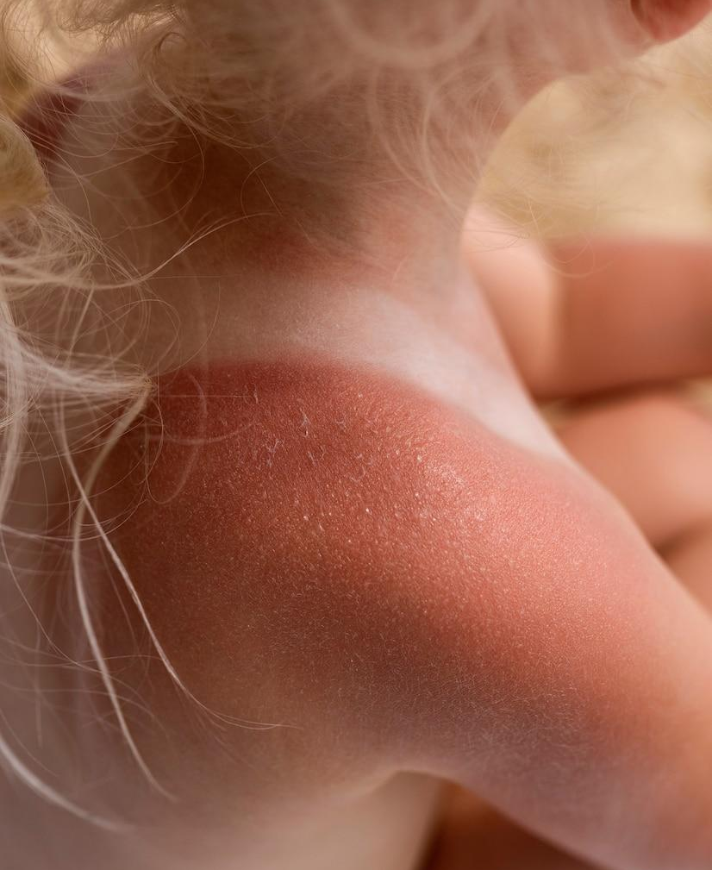
The Opportunity
$75bn spent on skin disease in the US¹
8.5% growth in Nurse Practitioners 2022-23²
¹American Academy of Dermatology
²American Association of Nurse Practitioners

Slide 7


Key Findings from Needfinding
Demand for automated triaging
Most PCP seen conditions can be seen by an NP/ PA
Scope of PA practice being refined
Patients want monitoring and questions answered

Slide 8
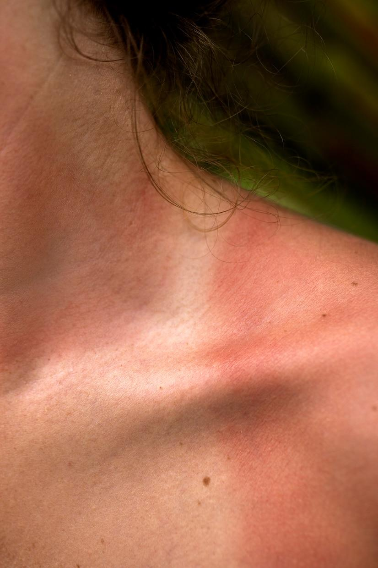
02
Market & Business Analysis

Slide 9
Market Size
2029¹
$148.4bn
AI in Healthcare
2024¹
$20.9bn
$24.8bn
AI in Healthcare
Teledermatology
48.1% CAGR
$8.7bn
$250mm
Teledermatology
~1% of market share
$90mm
~1% of market share
TAM
SAM
SOM
¹Markets & Markets, Fortune Business Insights

Slide 10

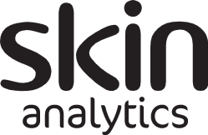


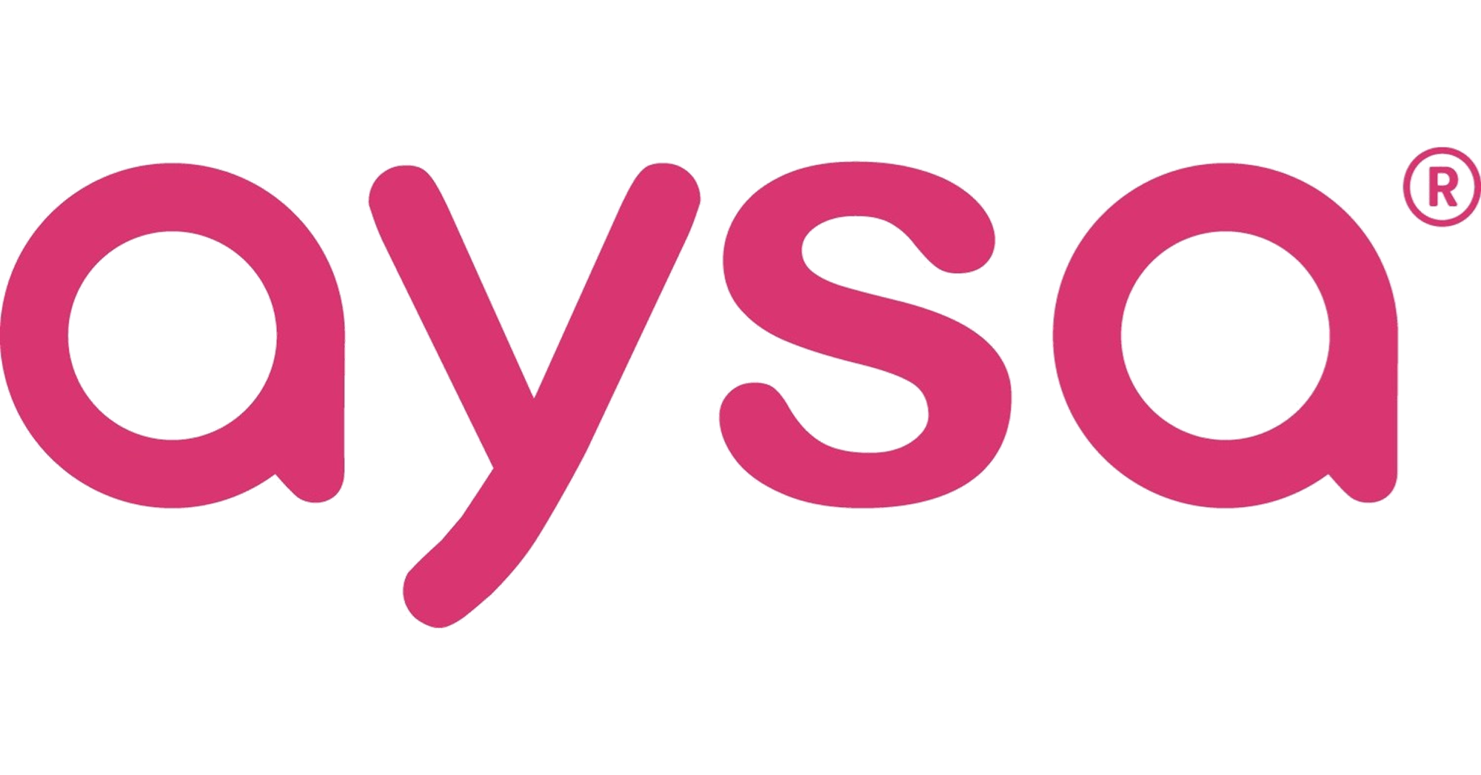

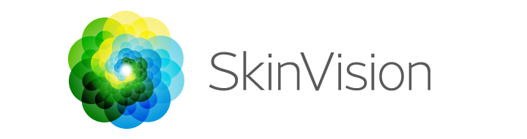
Market Analysis: Competitive Landscape
Number of Skin Conditions Tackled
All
Skin Sight
Low
High
Clinical Accuracy
A few

Slide 11
Skin Sight: an AI Triaging Tool
Patient with a skin-related query
Skin Sight AI
First Layer of Triaging
Then passed to a Healthcare Professional
Nurse Practitioners
Primary Care Physicians
Dermatologists

Slide 12
Proposed Business Model
1
2
3
Value Proposition
Customer Segments
Revenue Streams
Improved access to dermatological care
Healthcare professionals seeking triaging support
Insurance Payors seeking triaging for payments
Subscription Model for regular users
Pay-per-use for specialised use cases
4
5
6
Cost Structure
Key Partnerships
Channels
AI Development & Maintenance, Marketing, Research & Development
Collaborations with:
Technology providers
Skincare product companies
Healthcare professionals
Online platform
Mobile app
Partnerships with derm clinics

Slide 13
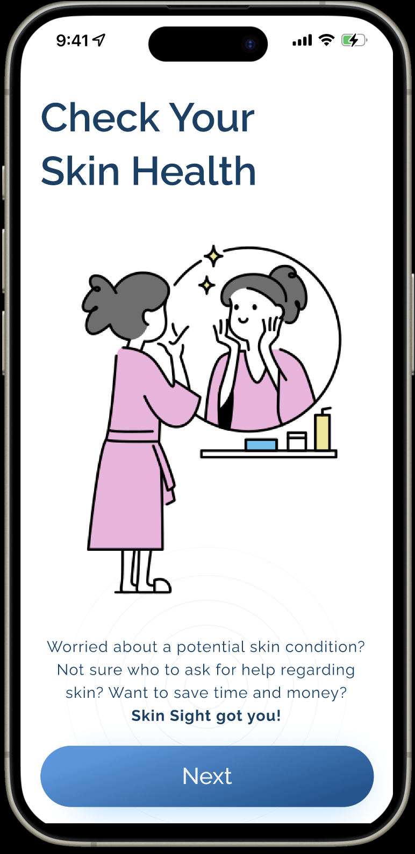
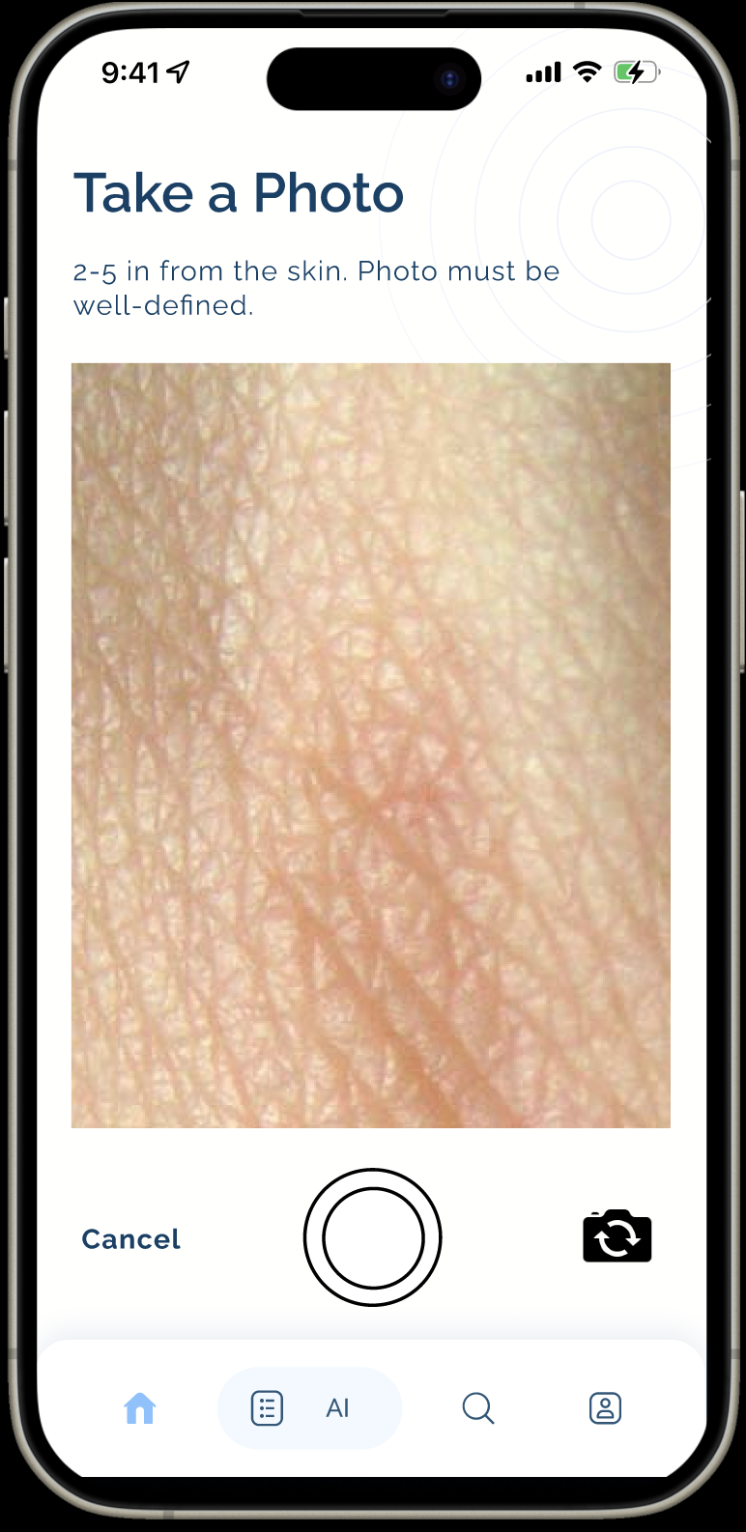
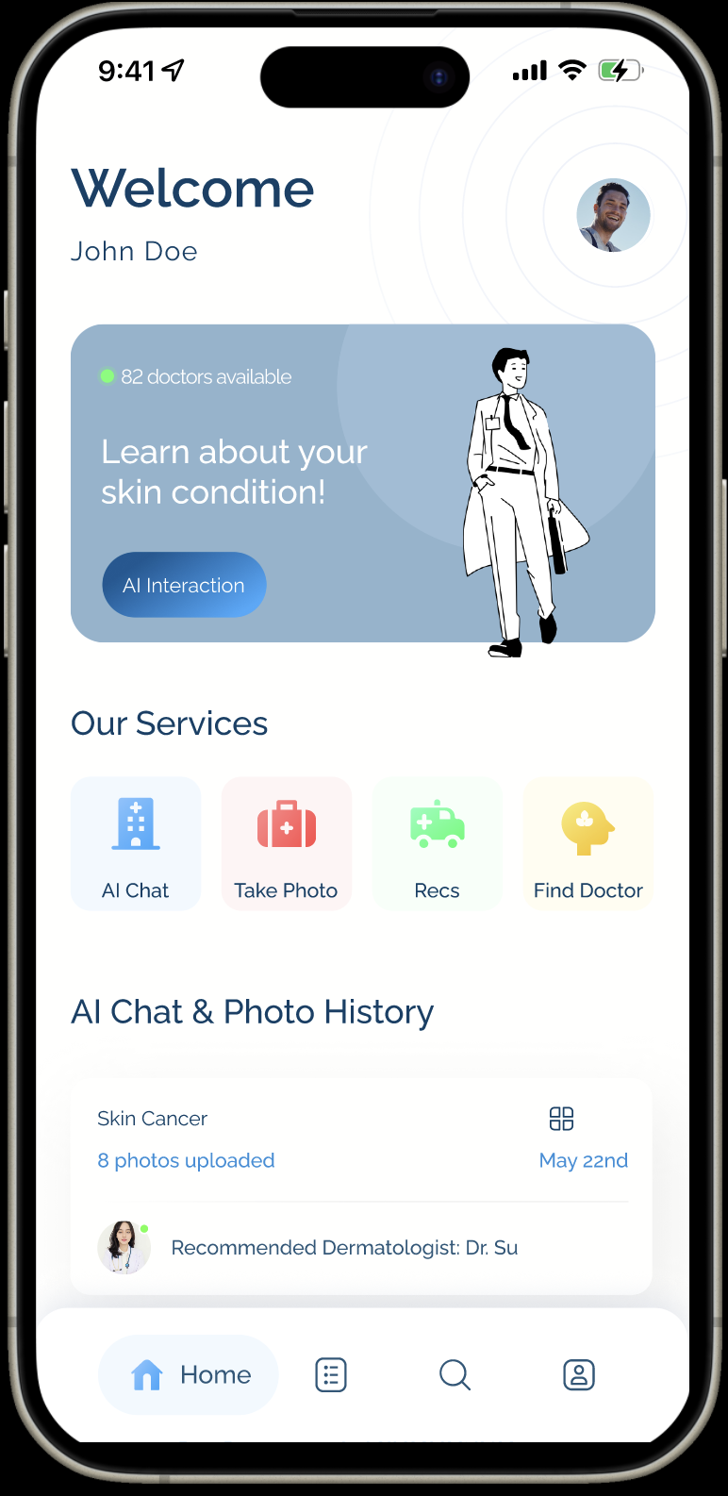
03
Product Demo

Slide 14
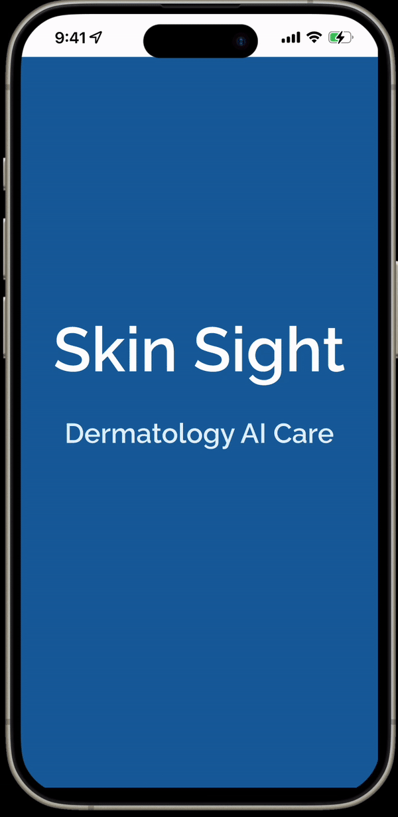
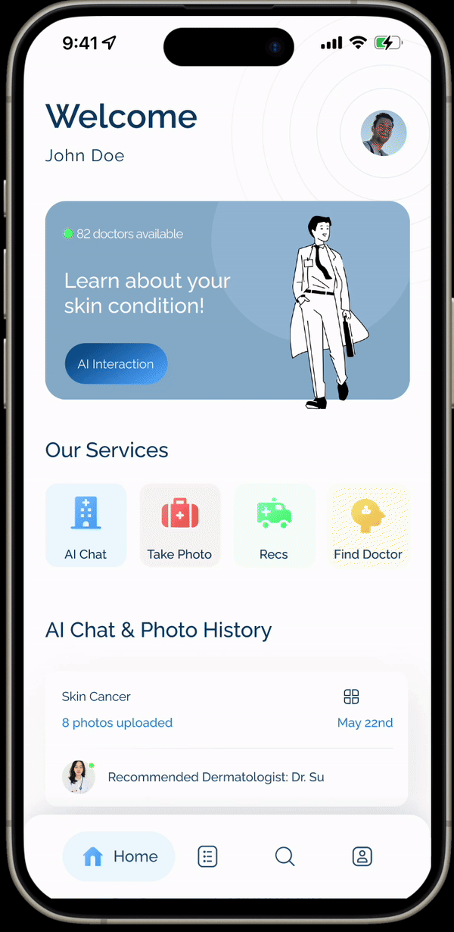
How the Product Works

Slide 15

04
Outcomes

Slide 16
Challenges & Successes
Successfully diagnosed common skin conditions
Vast Amount of knowledge
Diagnostic Accuracy
Integration of multimodalities
Achieved Success with Limitations
Need for Targeted Training
Developing robust validation protocols and Ethical guidelines
Cautious Integration into Healthcare
"AI in medicine is like a beacon in the fog of uncertainty: it illuminates possibilities but requires the guidance of human expertise to safely navigate the complexities of health." - ChatGPT

Slide 17
Desired Outcomes
Start
1
2
3
Reduced Healthcare Costs
Increased Accessibility
High User Satisfaction
Demonstrate cost savings from using lower-cost providers for non-critical care
Immediate results via telehealth
Shorter wait times
Easier access to care
Diverse database supports various ethnicities, skin colors, medical history backgrounds
Positive feedback from users regarding the ease and effectiveness of the system
Ensure the system meets all clinical safety and privacy regulations

Slide 18
Next Steps
Resource intensive Steps
Developing Front End and Back End
HIPPA
On-board HCPs
Seek legal advice
Creating a marketplace of providers
Time ++
Data security
Cost (tokens, app dev etc)
Speak to more nurses and PAs
Test low fidelity prototypes with patients, nurses, PAs and PCPs to get feedback

Slide 19
Thank You!
Any questions?

Slide 20
Appendix
The following slides are part of the appendix

Slide 21
Back-End
Context Setup
Set context based on input type and user interaction.
Prompt Refinement
Refine prompts iteratively based on prior responses.
Complex Query Simplification
Decompose complex inputs into simpler, actionable queries.
1. User Input Handling
2. Prompt Engineering Module
3. Medical History
Speech Input
Input verbal description
Image Input
Process image for skin condition detection.
Text Input
Direct text entry or converted from speech.
Initial User Questionnaire: Deploy dermatologist-approved questions to gather user’s medical history.
Dynamic Questioning: Based on initial answers, limit to no more than five targeted follow-up questions for precise diagnosis.
4. AI Model Diagnosis
5. Documentation and Guidelines
6. Outcome and Recommendations
Input Analysis
Analyze inputs using multimodal AI (speech, text, image).
Condition Prediction
Predict skin condition based on analysis and predefined models.
Condition Documentation
Retrieve details about conditions, potential severity, implications.
Healthcare Professional Recs
Recommend healthcare professionals based on condition severity and expertise required.
Diagnosis Delivery
Deliver precise diagnosis to the user.
Professional Referral
Guide user to appropriate healthcare professional based on diagnosis.

